Slide 1
FinTech Project
CEO Compensation and Stock Prices
Project G7
Andrea Ovelar
Carl Boitz
Alexis Schottenstein
Jeneia Mullins

Slide 2
Project Overview
Project evaluated the correlation between executive compensation and stock price performance
Team developed an interest in evaluating executive compensation when considering career paths in FinTech and comparing paths with finance versus technology companies
We analyzed these questions to our satisfaction thanks to the strong teamwork of the G7 team
In summary, the team discovered that executive compensation is correlated with stock price future performance - interestingly; based on direct salary, compensation for finance firms is at a much higher disparity to performance vs that of technology firms
Notes:
Carl

Slide 3
Questions to solve in this study
Does CEO compensation have a direct relationship with future stock performance ?
Does CEO tenure have a direct relationship with future stock performance ?
Does CEO approval rate by the board have a direct relationship with future stock performance ?
Does CEO ownership have a direct relationship with future stock performance ?

Slide 4
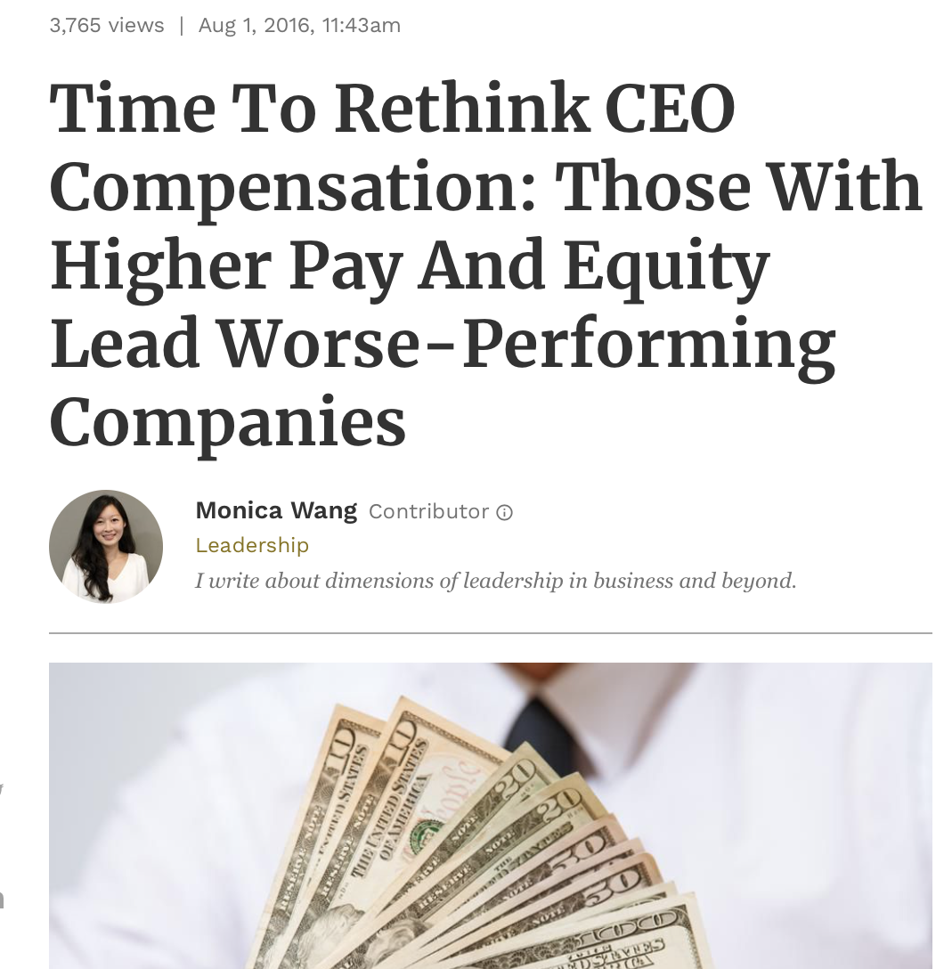
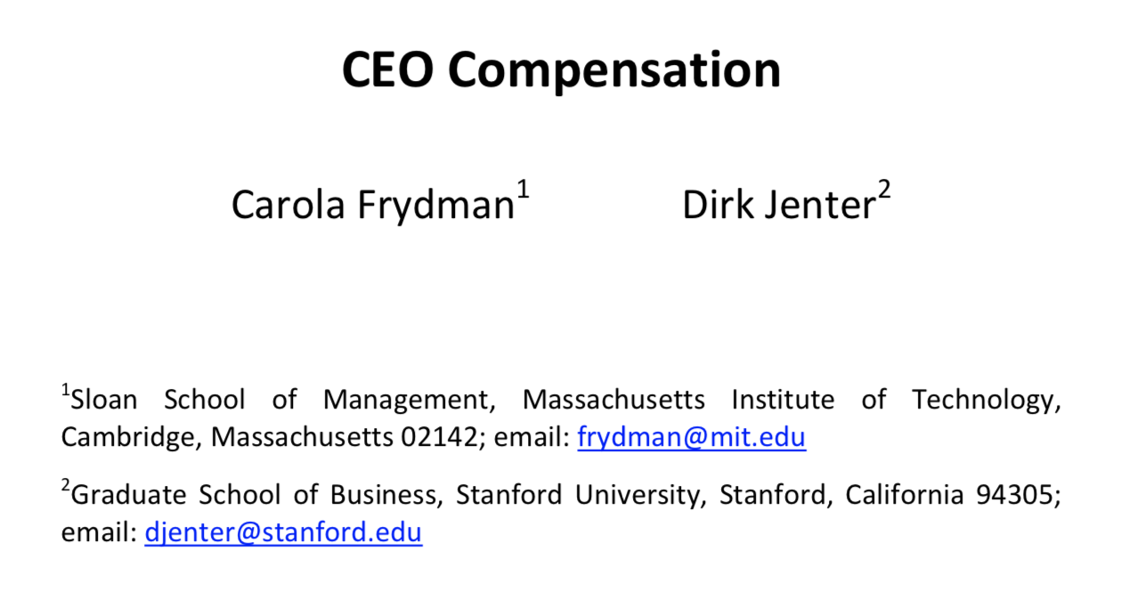
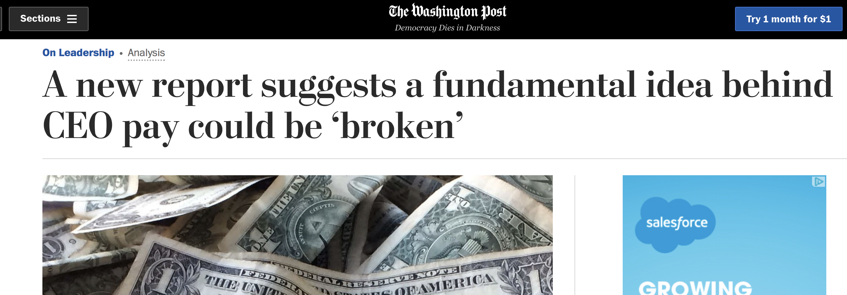
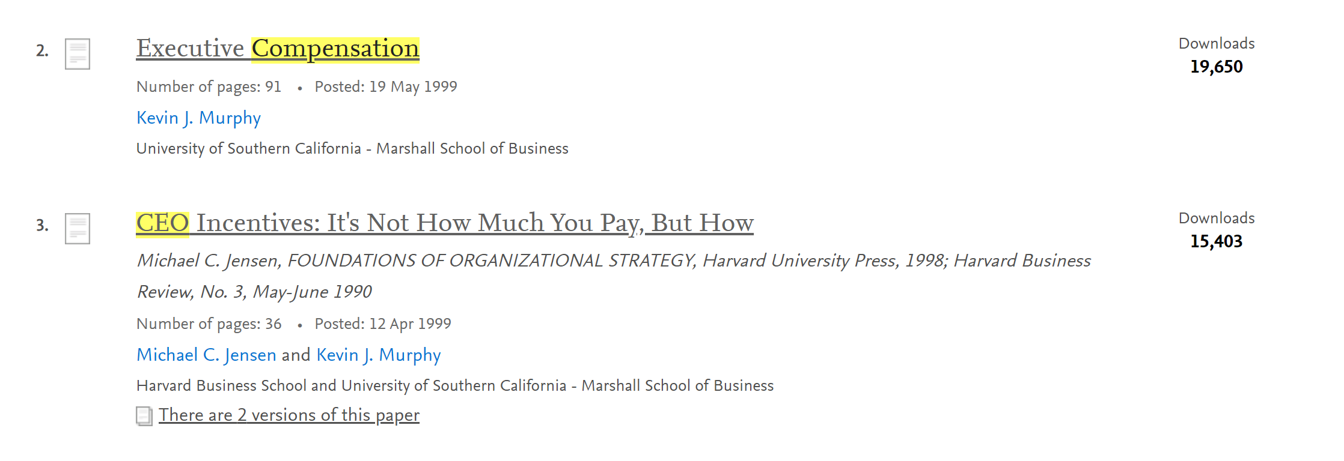
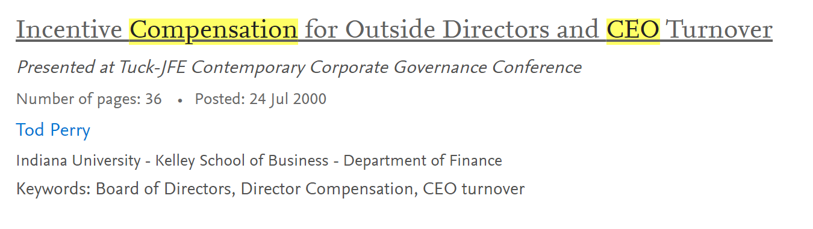
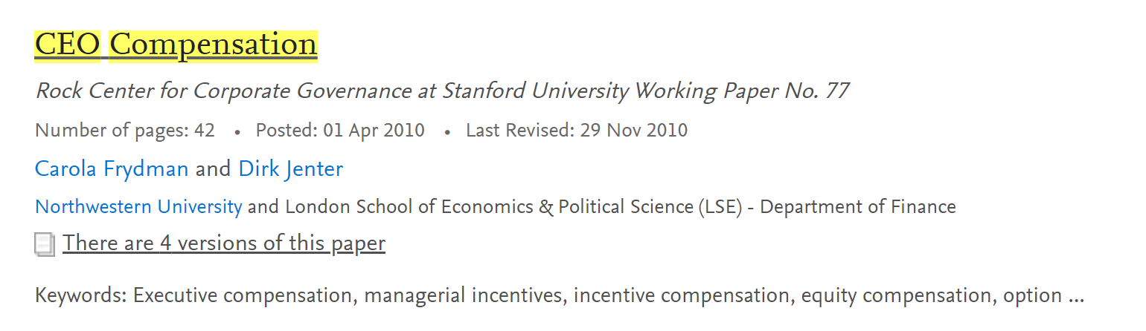
Does research support the relationship?
Academic research and news identify strong relationship between CEO compensation and stock price performance

Slide 5

Data
Aggregation
Challenges
Initial API Attempts Posed Several Challenges
Team was used to having access to meaningful data (often paid for by our employers)
Majority of free data available was limited to a small sample set or a shortened time frame
Free APIs restricted the number of requests an individual could extract
Notes:
Alexis

Slide 6






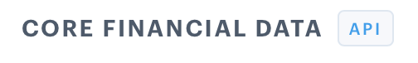
Data Findings
Notes:
Via API and excel

Slide 7









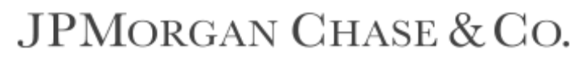




Data Exploration
Utilized two primary universes: Financial Firms (XLF) and Technology Firms (XLK) constituents:
Financial Firms (XLF)
Technology Firms (XLK)

Slide 8
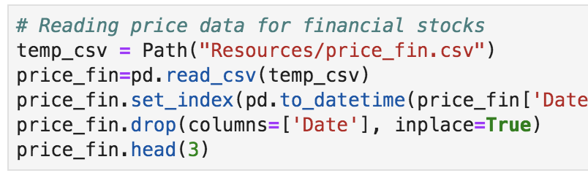
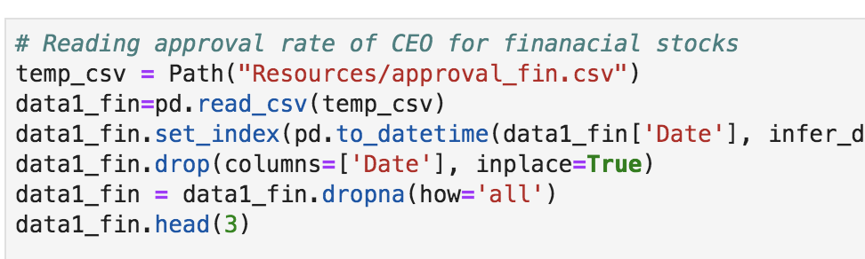
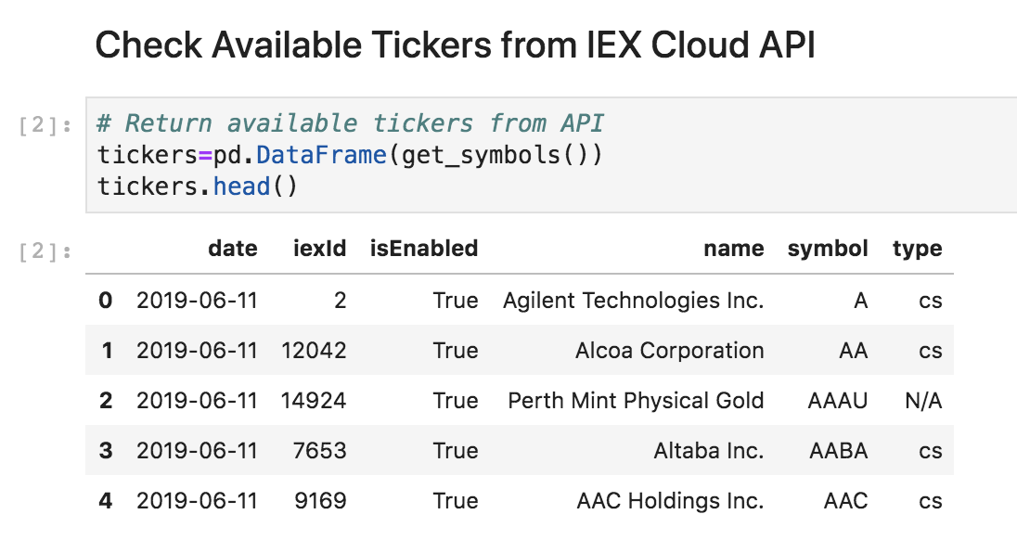
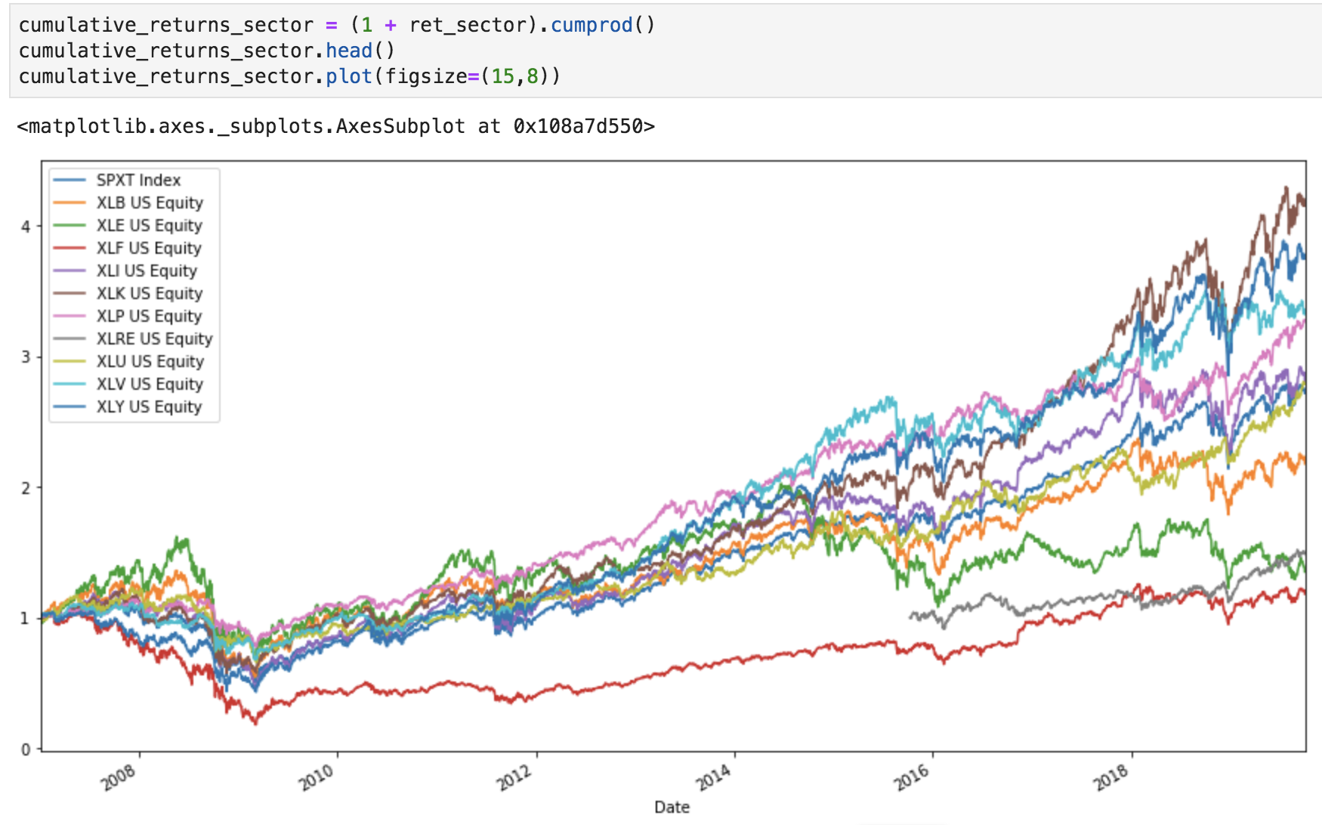
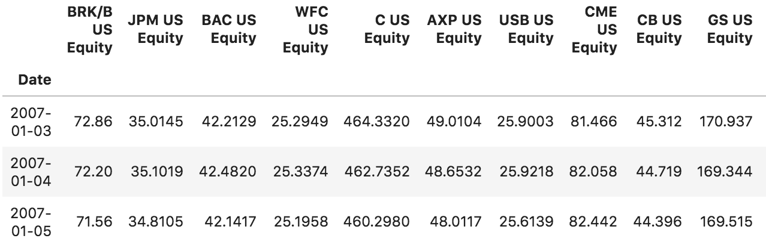
Data Exploration Continued, and Cleanup

Slide 9
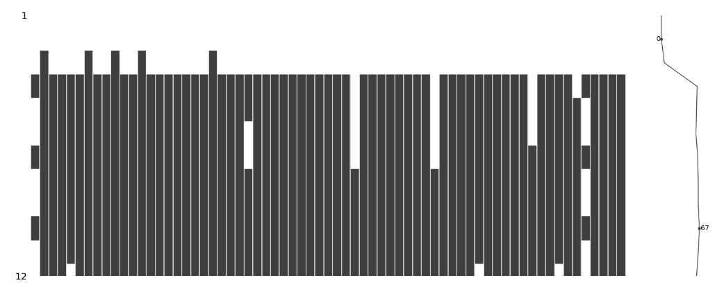
Data
Cleaning - missingno
We used a new package in order to inspect the data
It highlights missing data from the dataframes
Example of the output below

Slide 10
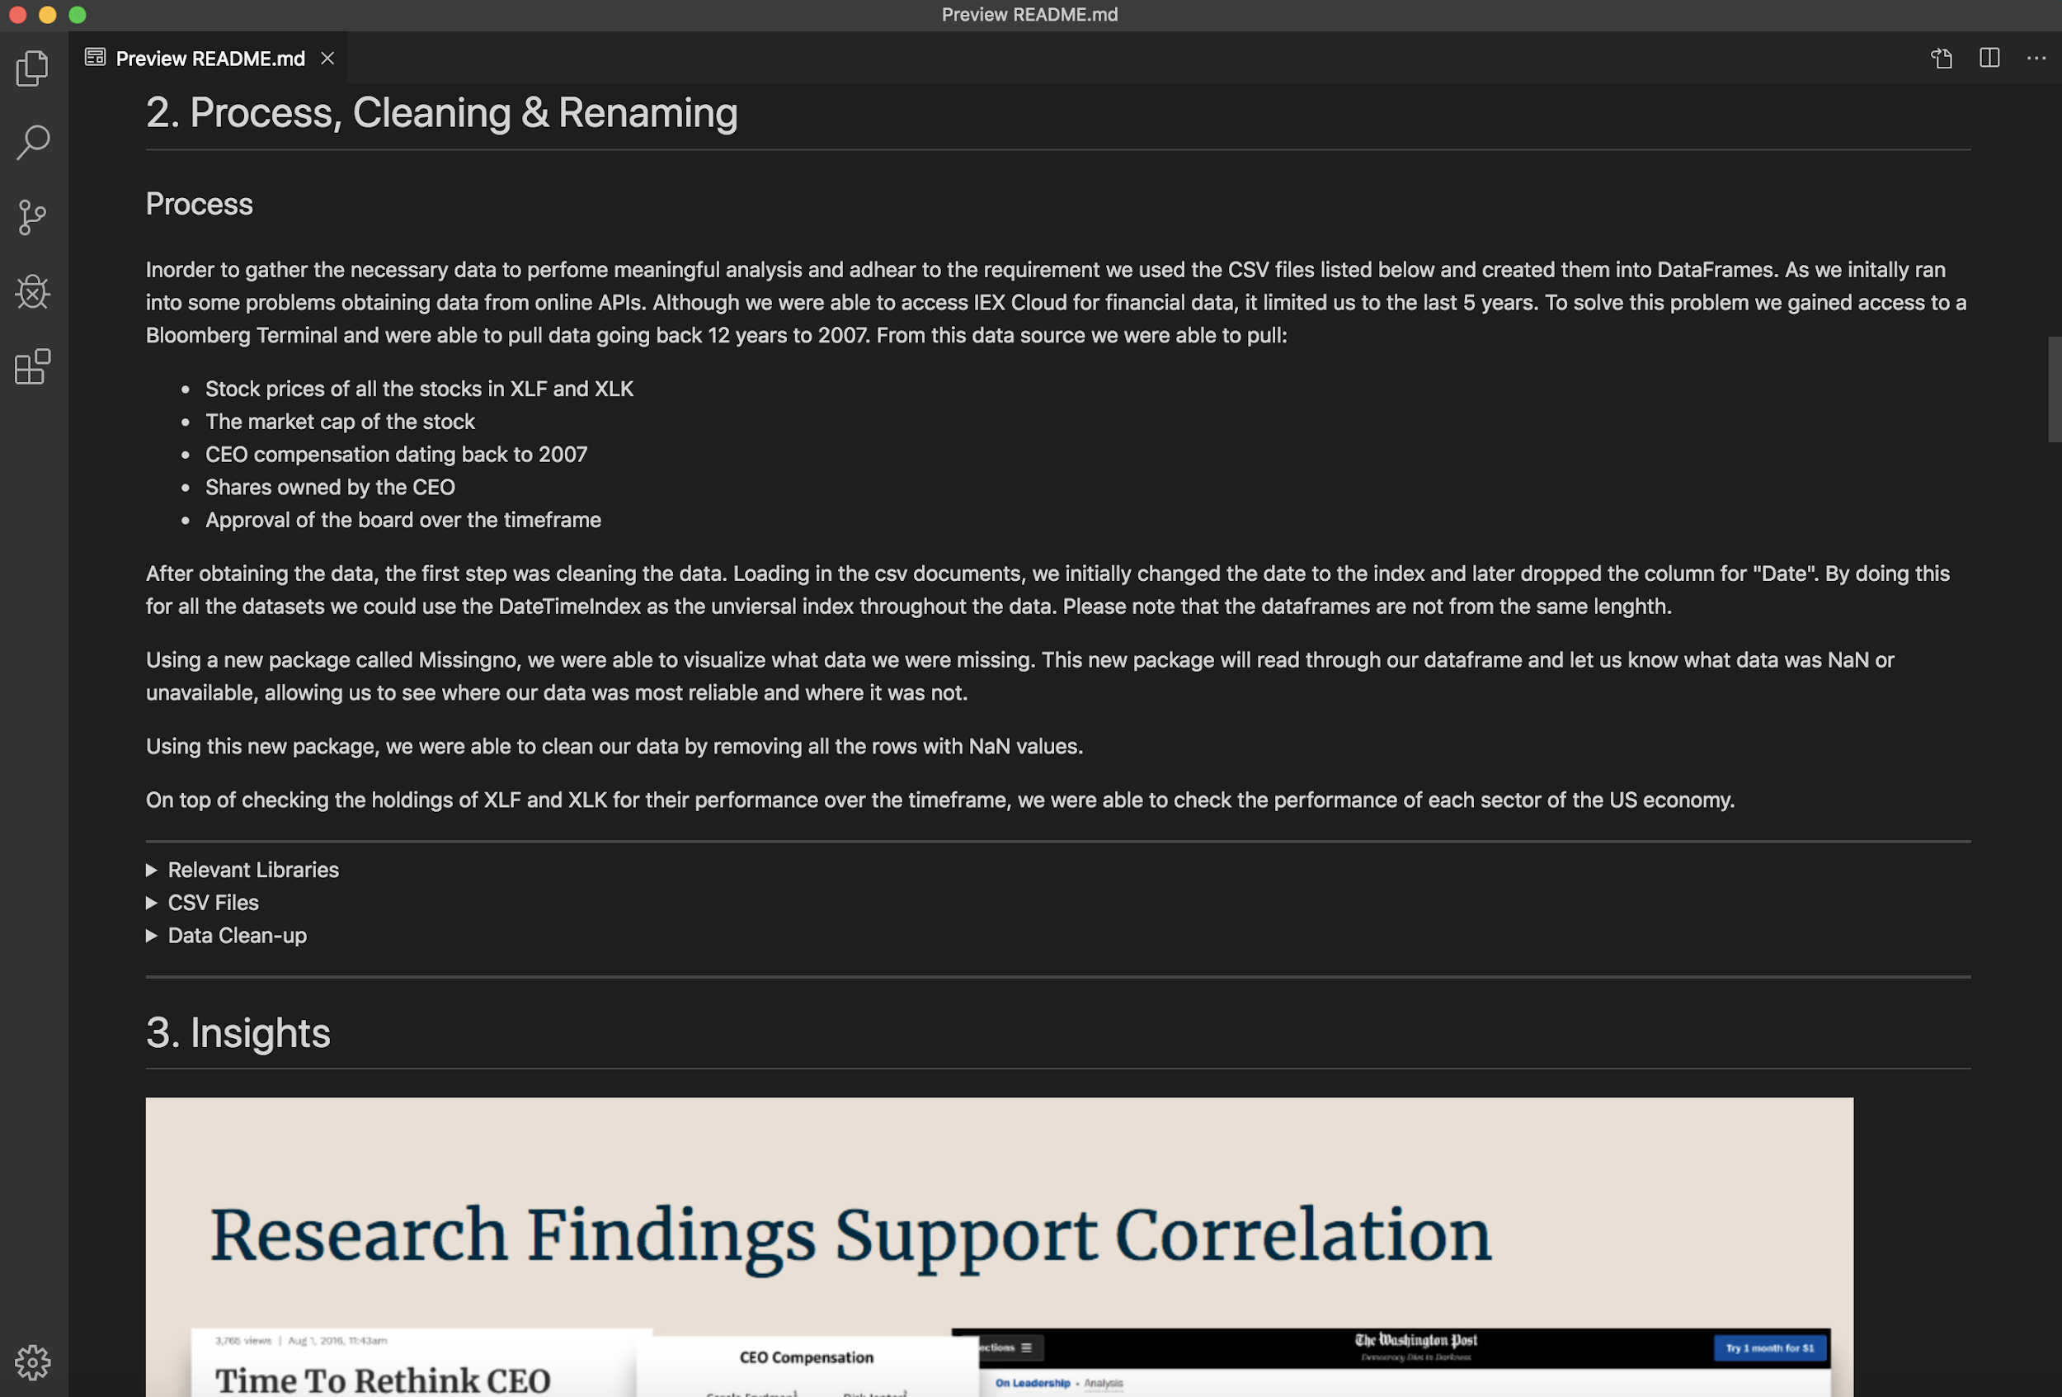
Markdown Example
https://github.com/KeepItOnTheDownload/FinTech-Group-Project/blob/master/README.md

Slide 11

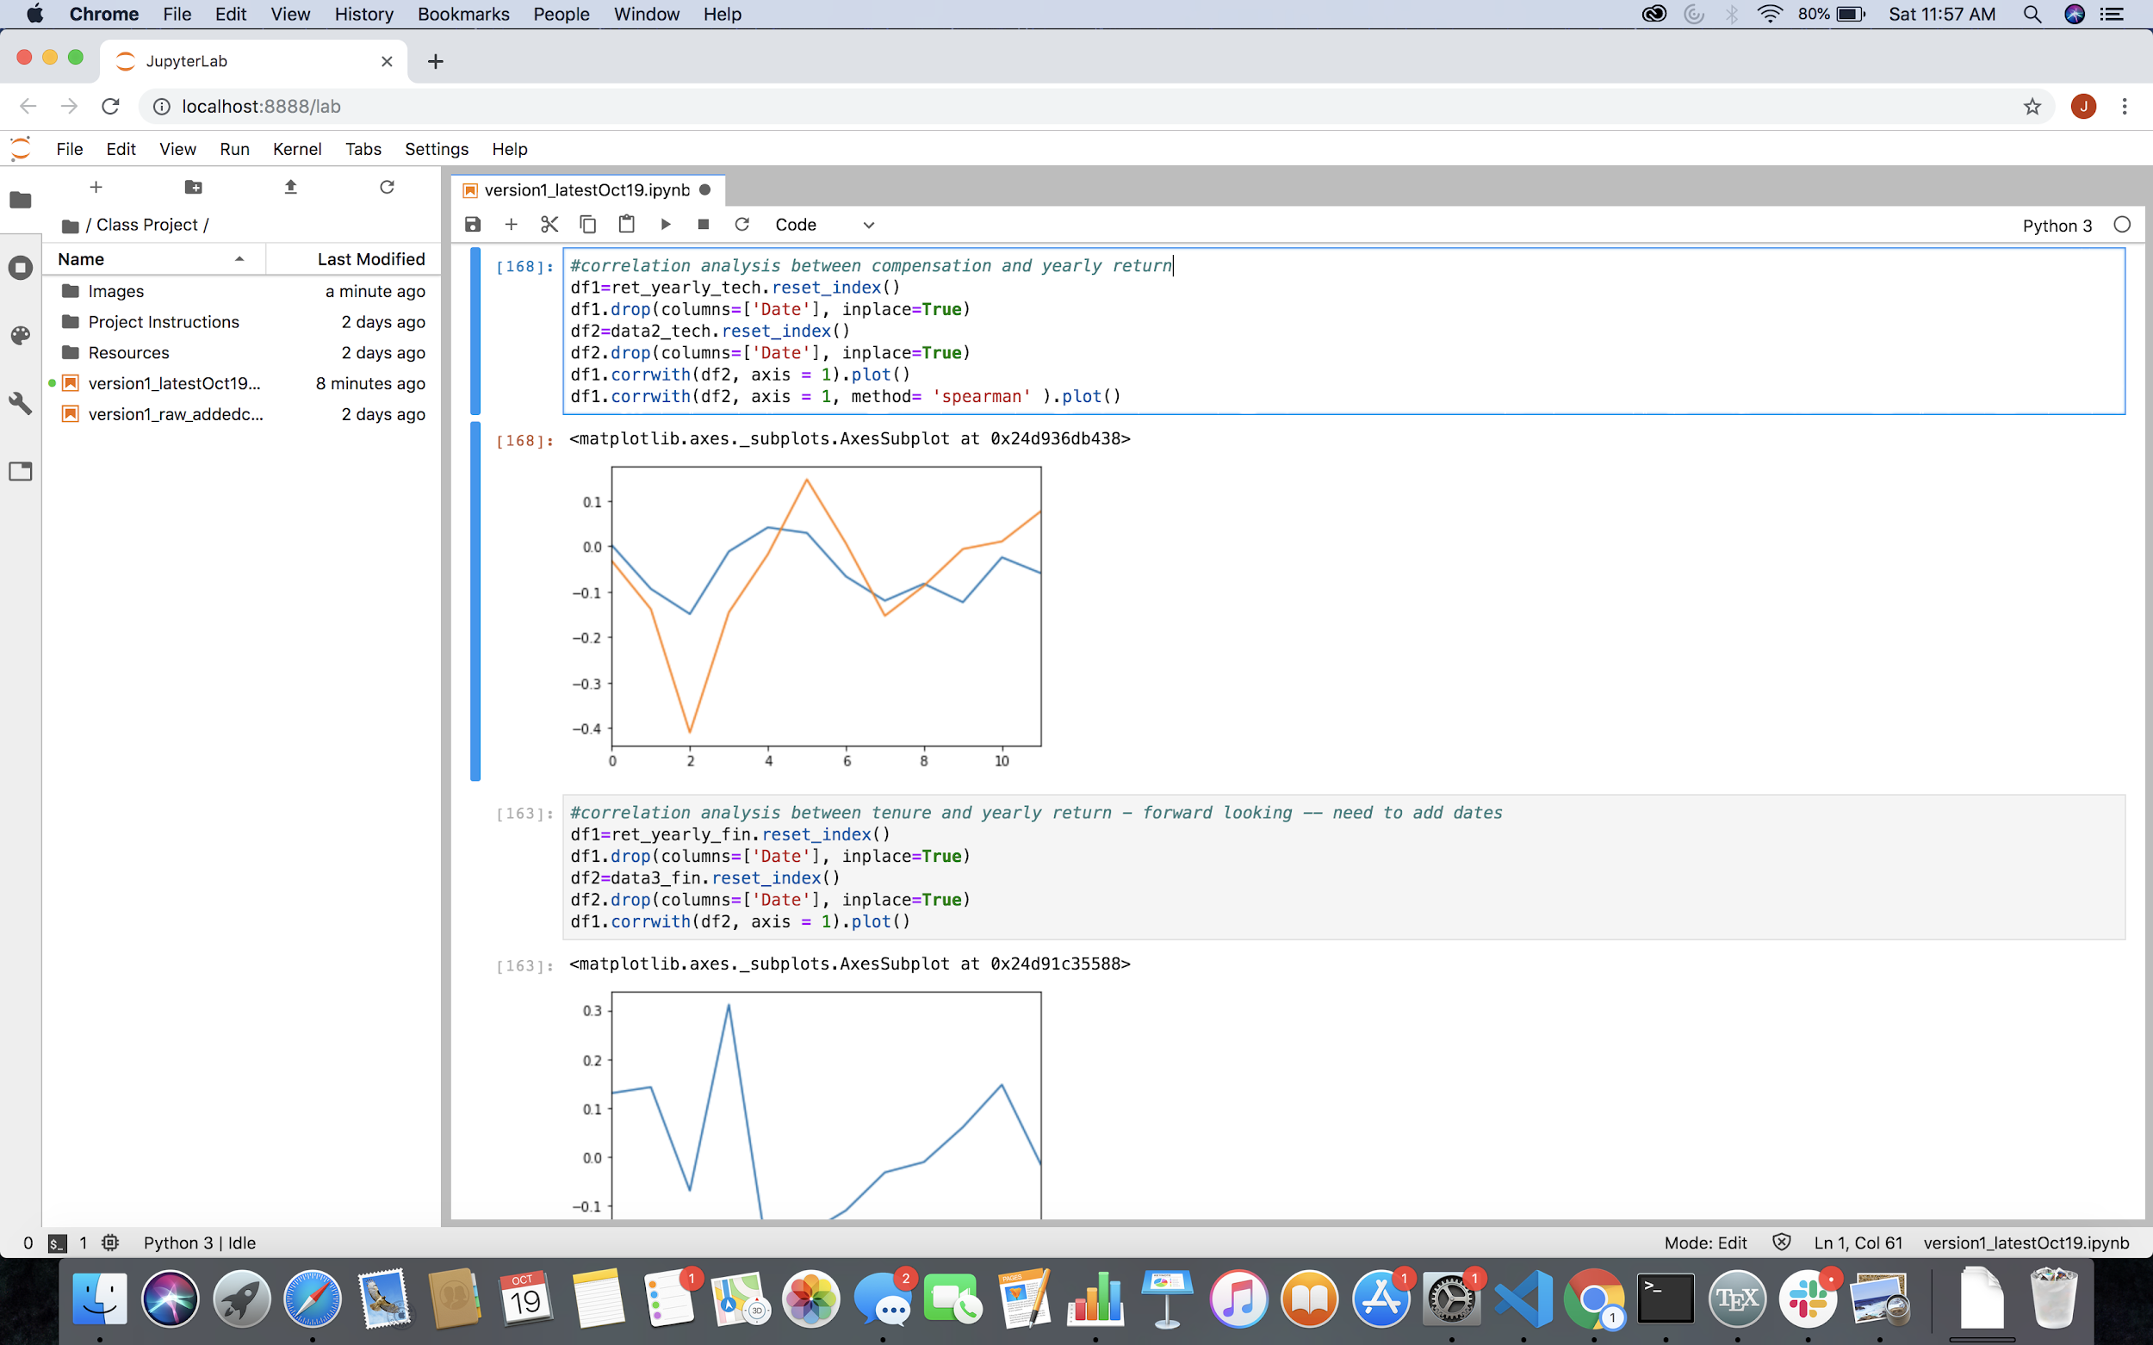
Analysis
Process
When evaluating the datasets, the team utilized the following process:
Created dataframes of the financial and technology firms
Built dataframes of compensation data and stock prices
Utilized Pandas to scrape and clean the data
Designed visualizations and charts to understand relationships and observe trends
Notes:
Andrea

Slide 12
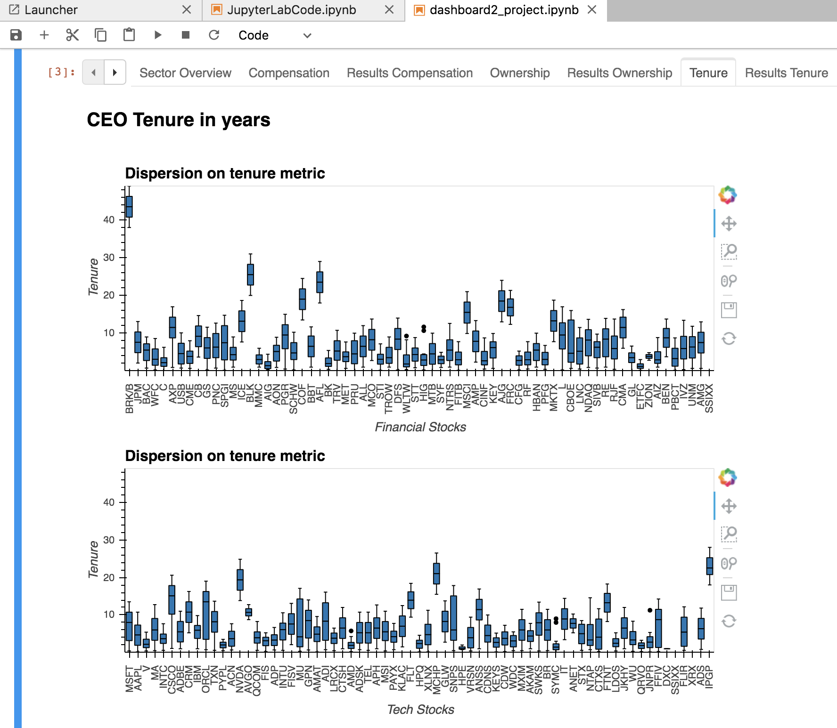
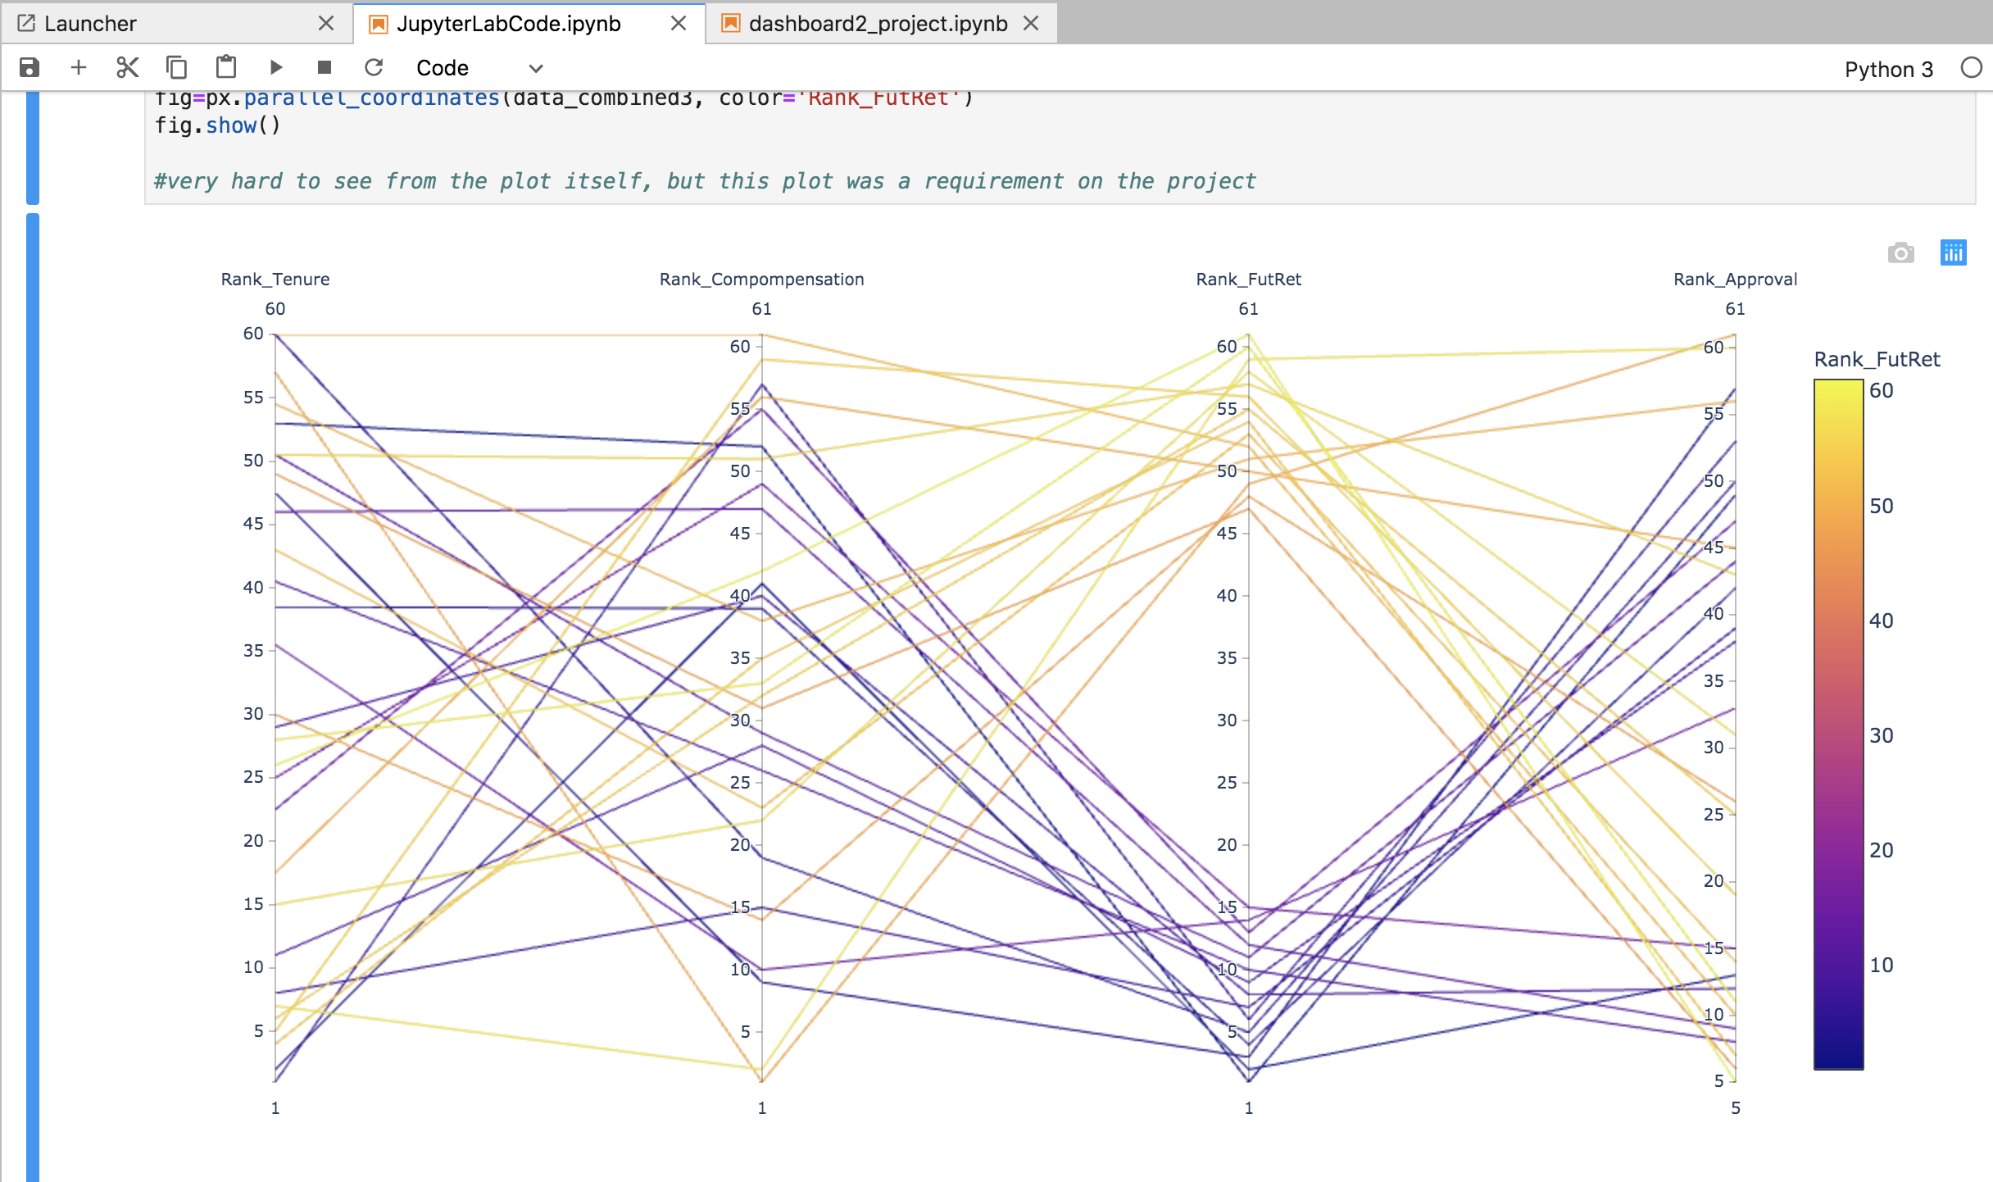
Chart Visualizations in Jupyter Notebooks
Dashboard Example
Interactive Chart Example
Demo Jupyter Notebook

Slide 13
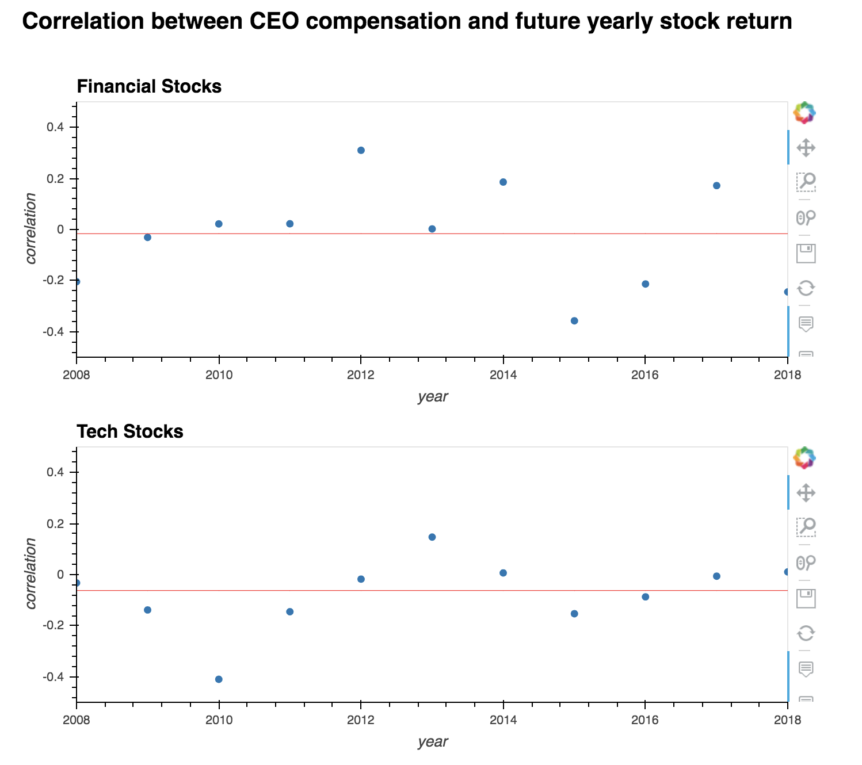
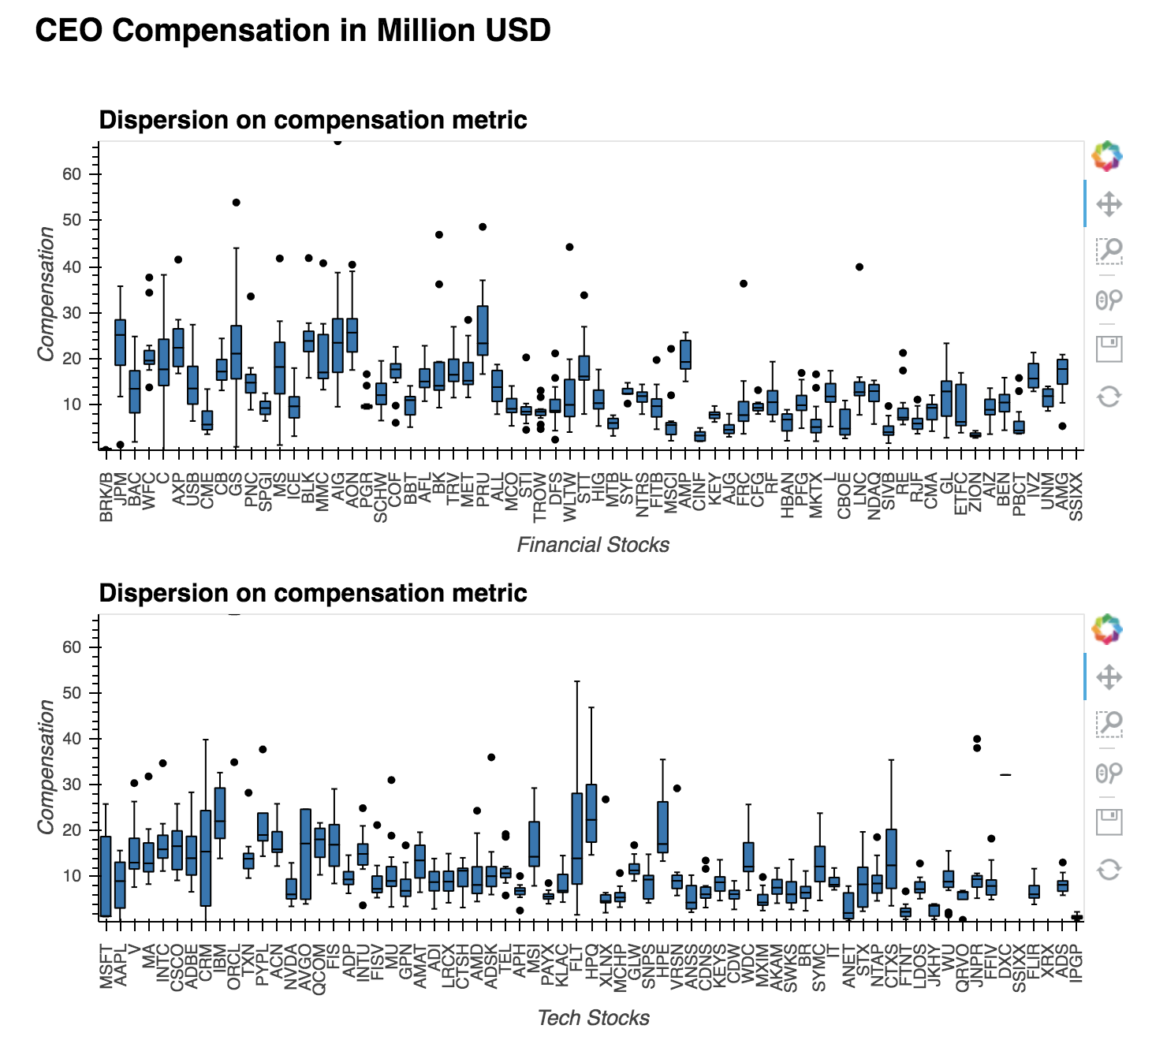
Correlation between Compensation and Stock Price Performance
Correlation between CEO Compensation and Future Stock Returns
CEO Compensation in Millions (USD)
Tech stocks showed a net negative correlation, whereas Financial stocks showed zero correlation
Financial firms show greater dispersion between compensation and price vs that of technology companies

Slide 14
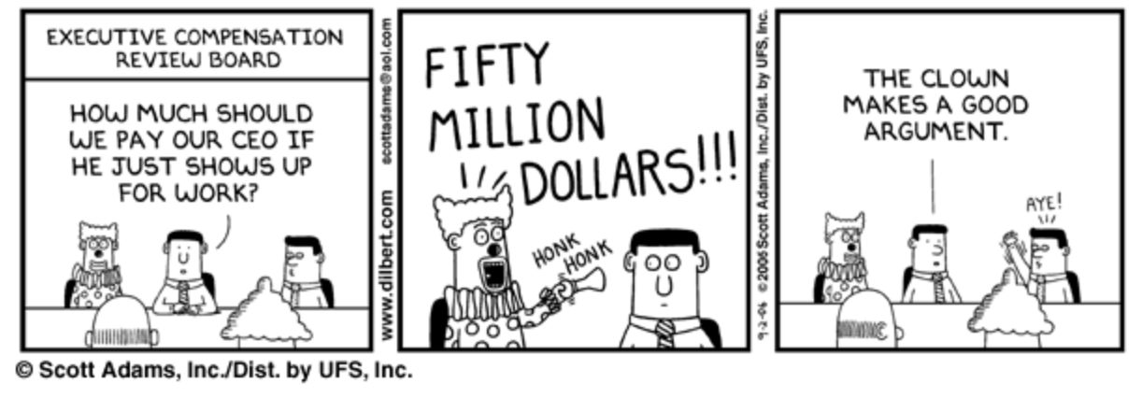
Key Takeaways from Analysis
CEO Compensation and Correlations to Stock Price:
We expected to find stronger correlations between compensation and stock price performance, and were surprised by the disparity of the results
Varying structures in compensation (stock vs cash) as well as timing may impact the correlation calculations
With incremental time, we would like to continue to analyze the details between the two dataframes to understand key drivers of correlation
Overall Project Takeaways:
Finding free quality data in sufficient quantities via APIs is challenging
Python data frames and libraries make analysis much faster to execute vs Excel
Interactive charts in Python enable you to form and test a hypothesis quickly
Teamwork is the best work!
Notes:
Jeneia

Slide 15
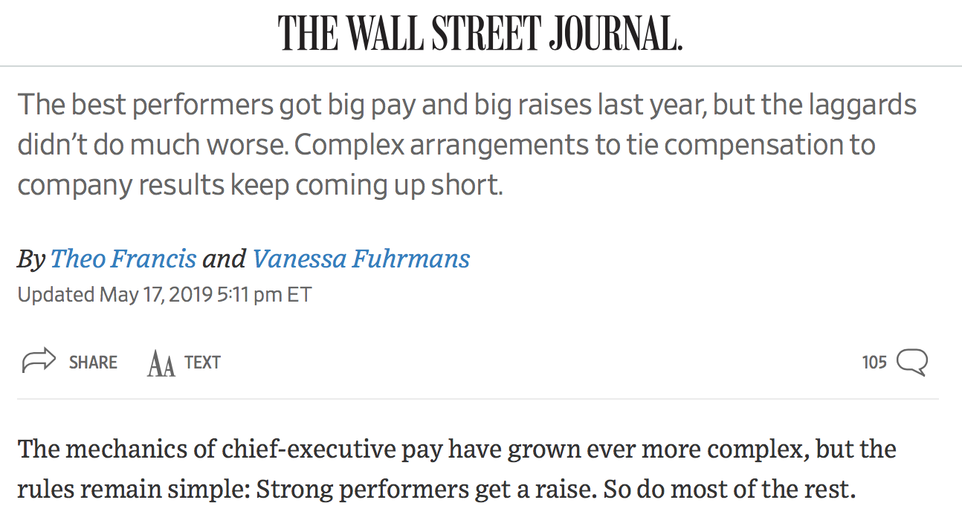
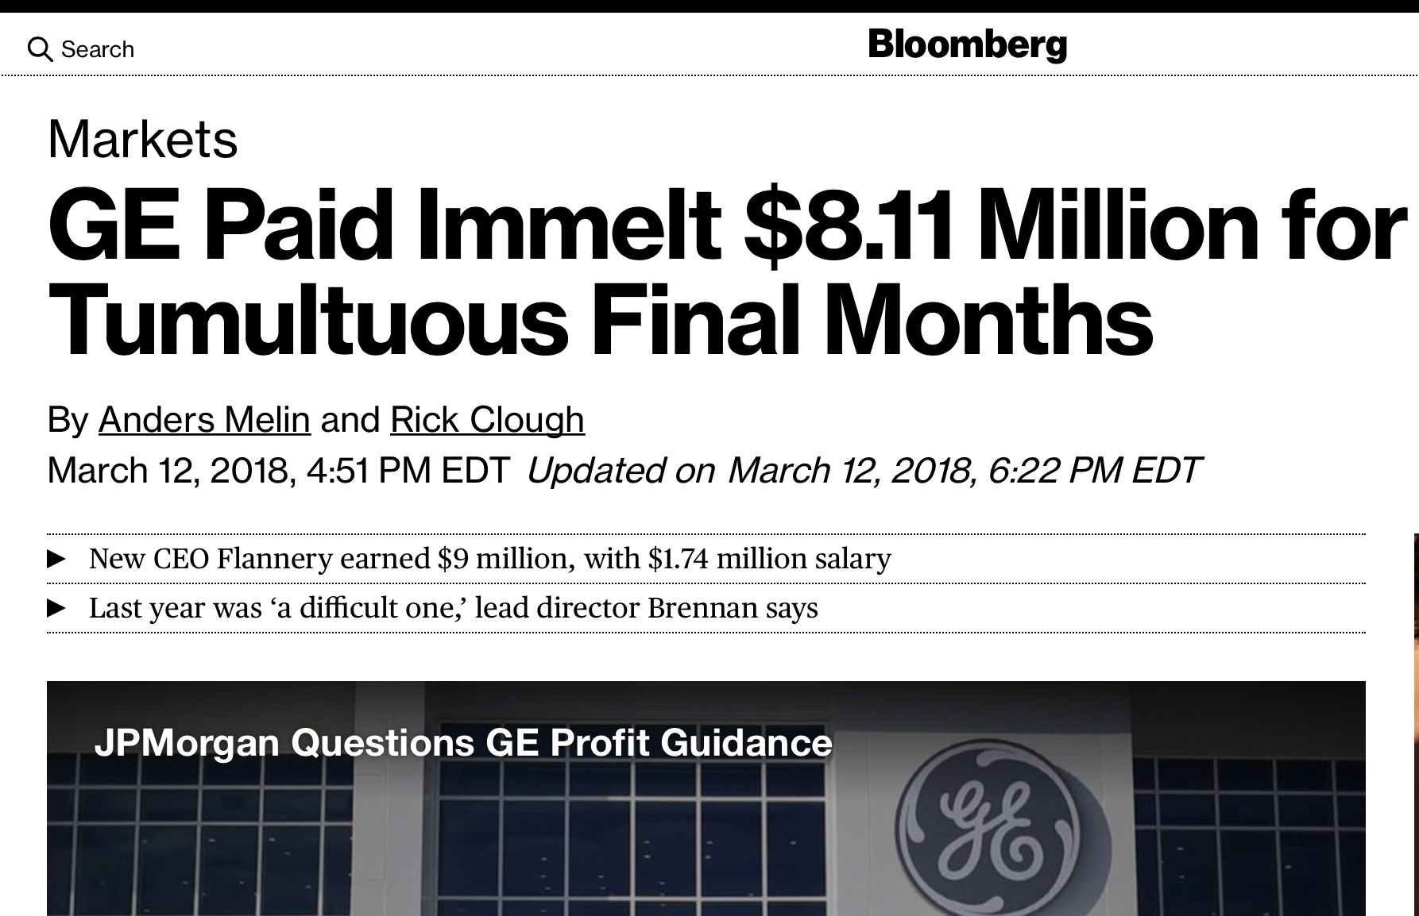
Considerations
Likely potential bias in dataset:
Companies selected for analysis (large corporates with available stock price and compensation data) likely have robust board control and tightly controlled compensation rules
As a result, the fact that compensation is highly correlated with stock price makes sense, as a tightly controlled company that is not performing well for shareholders will, hopefully, pay the CEO to directly correlate with the negative stock performance
The team observed that companies that have had CEOs paid millions despite long-term negative stock performance are likely not included in this dataset
For example, GE sold off the capital division and as a result, would not be included in the Financials selected for this analysis

Slide 16

Questions?
Team G7
Andrea Ovelar
Carl Boitz
Alexis Schottenstein
Jeneia Mullins

